Slide 1

Rotem Or Cloud Solution Architect Sela Group rotemo@sela.co.il

Slide 2
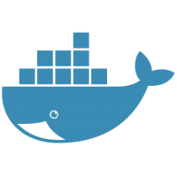
History

Slide 3
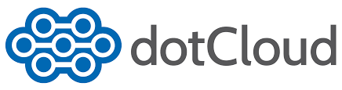
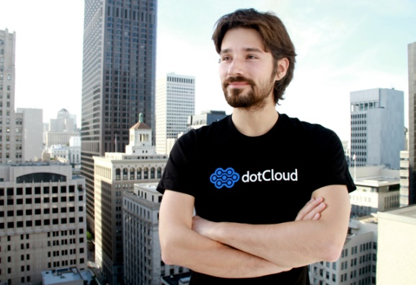

Solomon Hykes
2008 - a Paas (Platform as a service) company
Manages Infrastructure for companies and startups 2012 - dotCloud opened source the core technology of the company as a side project named Docker
A few month and this little side project became huge
200 contributors
5000 GitHub stars
1000+ tickets
250 pull request

Slide 4
Solomon Hykes
180,000,000$
3 years and 5 rounds

Slide 5
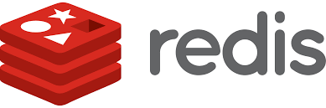




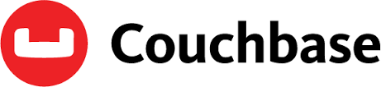
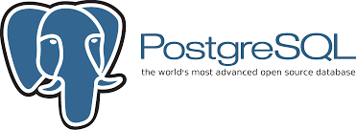



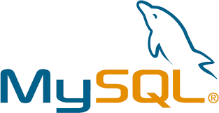



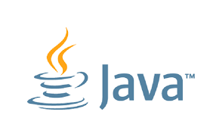
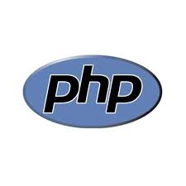
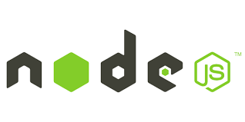
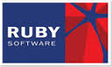
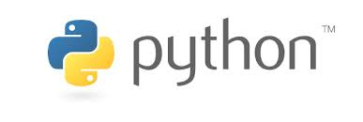
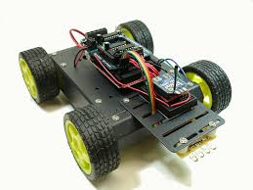
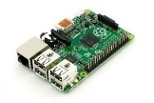
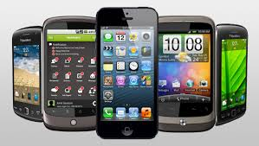
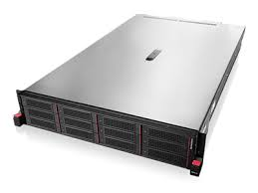
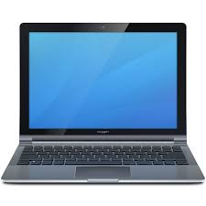
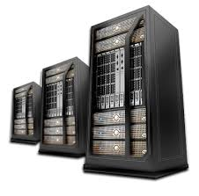
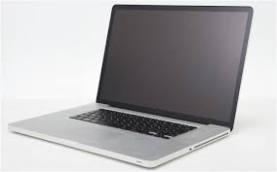
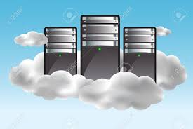
The Problem
Shipping code to server

Slide 6
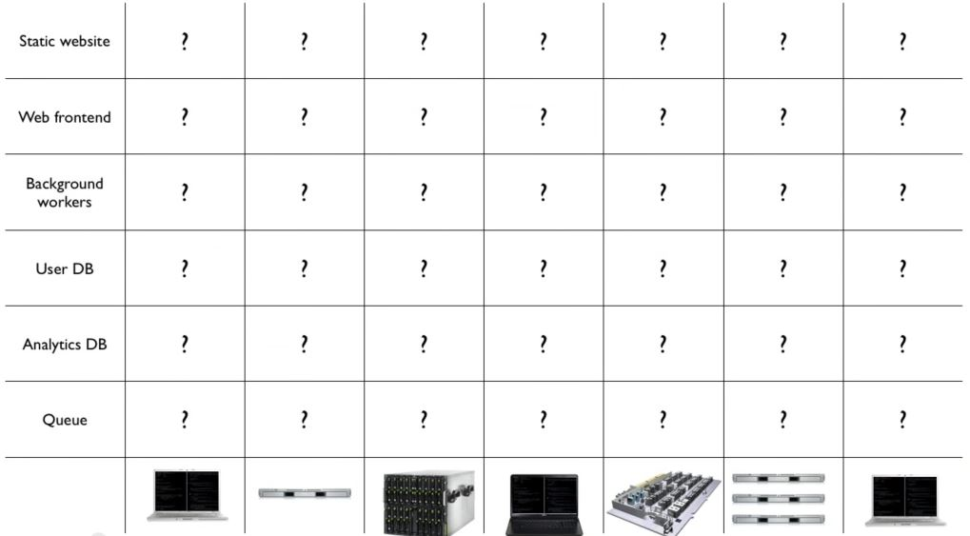
The matrix from hell

Slide 7
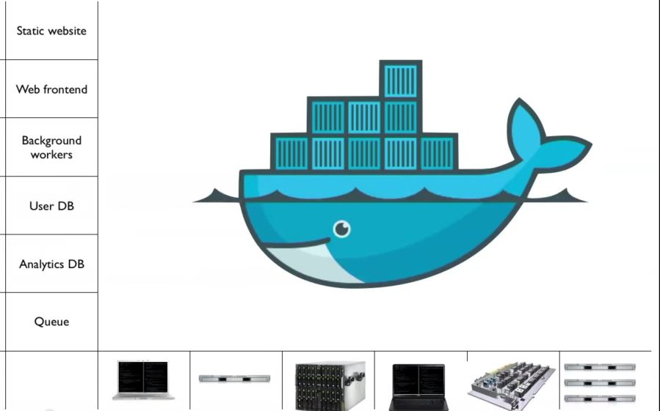
The Solution
Notes:
When you see “containers” you probably think of Docker. For good reason, Docker has essentially defined the container market. To understand what Docker is let’s start by looking at Containers.
Containers are an isolated environment and isolated collection of resources that an application runs in. The resources are all the dependencies (DLL’s, configuration, etc.) that the application needs. Everything the application needs to run is in the container and it sees nothing on the host OS it is running on (except maybe an internet connection). Containers are therefore a unit of deployment.
<click>
A key benefit of containers is that they can startup almost instantly. The notion of “booting up” a guest OS doesn’t exist. The container just runs on top of the host OS. As a result, containers can startup almost instantly as compared to the startup period of a VM. And because everything is contained in this container, containers are easily repeatable and extremely reliable from one environment to the next. For example, I can run a container on my local dev box and have high confidence it will run the same when deployed to another machine, such as a VM running in Azure.
<Click>
As you can probably imagine, containers are extremely popular in dev/test scenarios. They are also great for micro-services.
<click>
To put a visual behind this, consider the architecture for a typical virtual machine. You have a physical server, hyper-visor and host OS. Then, each VM has it’s own guest OS that can be configured with applications and application frameworks. This is what you saw earlier in the presentation.
<click>
Now consider how a container is different. Physical Server with a host OS. However, notice there is not a guest OS. The container is essentially the application and it’s dependencies. Also notice that the app frameworks used by application A and application B are shared in this model. This is how instant startup is achieved.
Note that there are more instances of the same App running on the physical server. This underlines that a container is a scale unit besides being an isolation mechanism. In a production development you would use a cluster of hosts, and have containers spread of the hosts.

Slide 8
Virtual Machine VS Docker Containers
Notes:
Docker has also pretty-much defined the container ecosystem (de-facto standard). It provides the means for deploying these containers and resources onto a machine by developing a Docker API that drives these activities.
The container runtime traditionally only ran on Linux VM’s. However, today, Windows Server 2016 provides a new “Container Role” (similar to other roles like AD, File Server, etc.) that you can configure on Windows. This provides the same abilities to create and manage containers that exists on Linux.
<Click>
Docker has also become the standard for defining what a container image looks like. The file format, the manifest that goes into the container, and how image dependencies are configured. And Windows and .NET are perfectly valid candidates for a Docker image.
<Click>
Docker has become the standard place for people to publish their images. Docker Hub is a public “trusted repository” where you can find literally thousands of Docker images such as Apache, MySQL, and even .NET.
Microsoft Azure embraces this container technology and has integrated it directly into the platform.

Slide 9
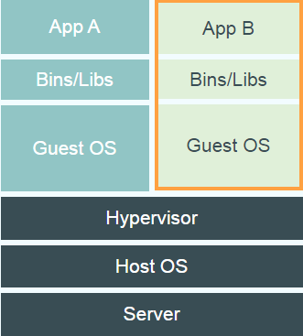
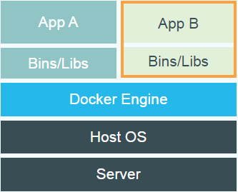
VM vs Docker
Virtual Machines
Each virtualized application includes not only the application - which may be only 10s of MB - and the necessary binaries and libraries, but also an entire guest operating system - which may weigh 10s of GB.
Docker
The Docker Engine container comprises just the application and its dependencies. It runs as an isolated process on the host operating system, sharing the kernel with other containers. Thus, it enjoys the resource isolation and allocation benefits of VMs but is much more portable and efficient.

Slide 10
Docker Hub https://hub.docker.com/
Large Community
You can find official docker images from known vendors
You can share and download docker containers from any where around the glob other users around the glob

Slide 11
Docker Everywhere

Slide 12
Docker Everywhere
Docker can run on any platform today:
Linux
Windows
OSX
AWS (EC2 Containers)
Azure (VM/ Container Service)
Rackspace
…

Slide 13
Basic WebApp

Slide 14
Docker Files

Slide 15
Docker File – Definition of a container
FROM ubuntu:14.04
RUN \
apt-get update && \
apt-get -y install apache2
ADD index.html /var/www/html/index.html
EXPOSE 80
CMD ["/usr/sbin/apache2ctl", "-D", "FOREGROUND"]

Slide 16
Docker Compose

Slide 17
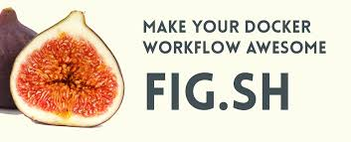
Fig == Docker Compose
Fig
Docker Compose
Run and manage multiple containers from script
Linking between containers
Exposing ports
Volumes

Slide 18
Docker Compose YML file
web:
build: .
command: python app.py
ports: - "5000:5000“
volumes: - .:/code
links: - redis
redis:
image: redis

Slide 19
Basic WebApp + Scaling

Slide 20
Docker In the Cloud

Slide 21
Run docker on your favorite cloud
Docker is running in the cloud , and it keeps spreading out
Microsoft Azure
Amazon EC2
Google Cloud Platform
Rackspace Cloud
IBM SoftLayer cloud
Joyent Public Cloud
… many others

Slide 22
Azure
Azure VM
Azure Container Service
Amazon AWS
EC2 VM
EC2 Container Service
Google
Compute Engine
Container Engine

Slide 23
Azure
Swarm is a simple way to setup and deploy docker containers on multiple servers using both docker and compose
You run your cluster in very much the same way you would run a single container or compose file
Swarm will handle all the discovery and port configuration for you
Select the most available recourses on your cluster to deploy your container

Slide 24
Docker From Dev To Production

Slide 25
Dev
The developer knows best what his server needs.
When he writes the application directly on containers the containers can be cloned to any environment with 0 effort No more “But It works my laptop” in a middle of a major deployment

Slide 26
Test
Use docker to spin a a full testing environment on any machine server or cloud in just a few clicks
Minimize the testing effort for different environments

Slide 27
Production
Manage your production in the most flexible way
Scale in milliseconds
Never be tied to a specific provider
Work in sync on multiple clouds

Slide 28
Skateboarding is not a crime

